Slide 1
Lesson 5
Metrology
Notes:
Lab #1
Skills review
HW#1 posted

Slide 2
Washington's Dream

Slide 3
Metrology
We can never know the true state or parameters of any system or object.
We can attempt to understand a state or parameter by taking a measurement.
→ All measurements have some uncertainly though.
→ The best we can do is gain an estimate of a state or parameter.
Metrology: the science of measurement
Metrology encompasses:
Definition of units of measurement
Realization of these units of measurement in practice
Traceability

Slide 4
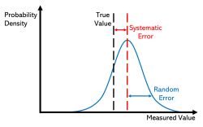

Uncertainty
"Any measurement that you make without the knowledge of its uncertainty is completely meaningless"
Common statistical model used is that the error has two additive parts:
Random error: Measurement variance from one observation to another.
Systematic error (bias): always occurs with the same value when we use the instrument in the same way and in the same case.
Sensors are often approximated as linear systems:
$$y\left(t\right)=Sx\left(t\right)+b+n(t)$$
Where:
$x\left(t\right)=$ input (measured physical quantity, e.g., temperature, pressure, acceleration)
$y\left(t\right)=$ output (electrical signal, e.g., voltage, counts)
$S=$ sensitivity (gain, scale factor, output/unit input)
$b=$ bias (offset, zero error)
$n\left(t\right)=$ noise (random error term)

Slide 5
Other Sources of Uncertainty
Drift and Aging
Sensor characteristics change over time
Particularly important for long-duration missions
Environmental Sensitivities
Temperature
Radiation
Vibration and launch shock
Vacuum effects (outgassing, thermal gradients)

Slide 6
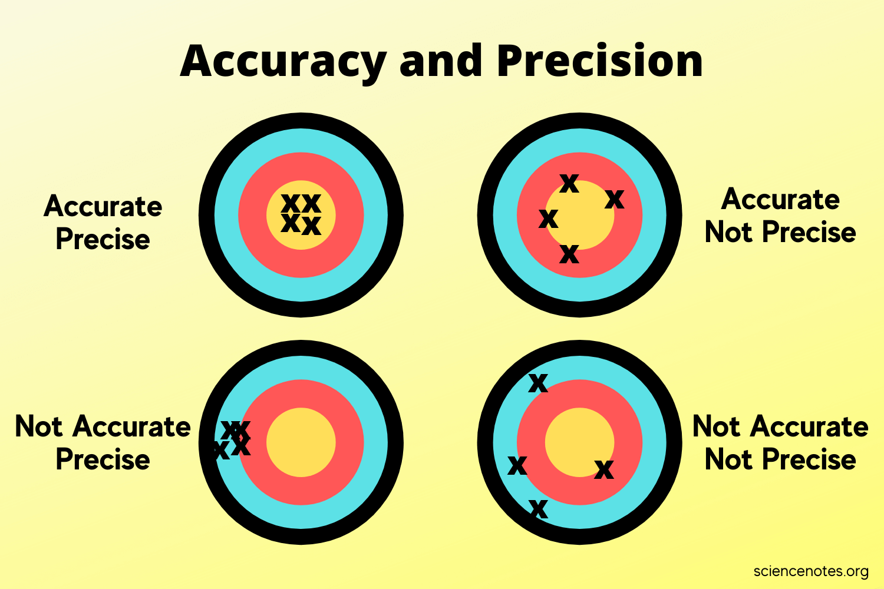
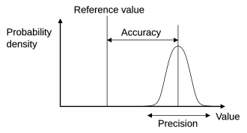
Accuracy vs. Precision
Accuracy and precision describe observational error.
Accuracy: how close a given set of measurements are to their true value → Correctness
Precision: how close the measurements are to each other—a measure of statistical variability) → Repeatability

Slide 7
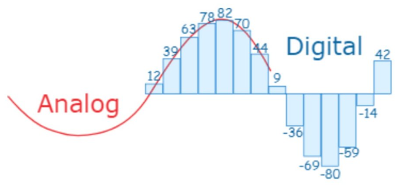
Analog & Digital
Analog: Continuous signal that can take on any value in a range.
Digital: Discrete signal with a finite set of values.
Analog-to-Digital Converter (ADC): converts continuous analog signal into a digital representation that can be processed, stored, or transmitted by digital systems.
Resolution: smallest change in input signal that the ADC can detect, determined by the number of bits it uses to represent each measurement.
8-bit ADC → 2⁸ = 256 levels
12-bit ADC → 2¹² = 4096 levels
16-bit ADC → 2¹⁶ = 65,536 levels
Quantization error: the difference between the actual value of an analog signal and the nearest digital value assigned to it during analog-to-digital conversion.

Slide 8
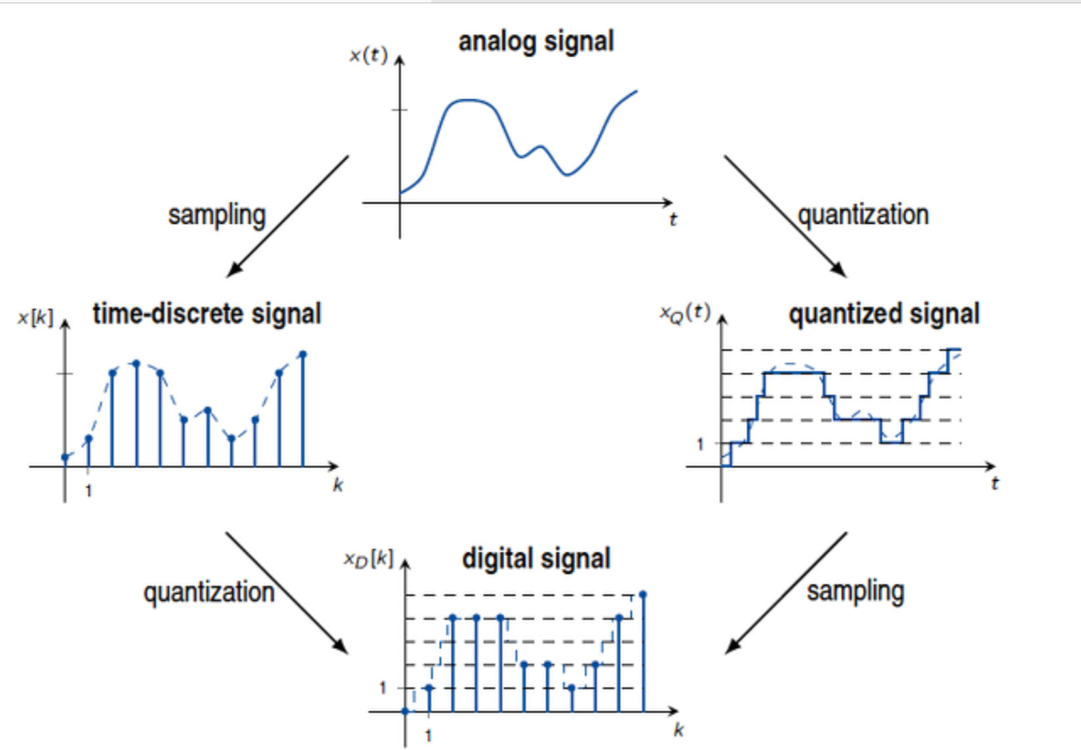
Discretization/Quantization
Discretization: process of converting a continuous signal into a sequence of values defined at discrete points in time (sampling).
→ Sample at fixed intervals
Quantization: The process of mapping a continuous range of values into a finite set of discrete levels.
→ Round values to fixed levels
Together, these steps transform an analog signal into a digital signal that can be processed by embedded systems (analog to digital conversion → ADC).

Slide 9
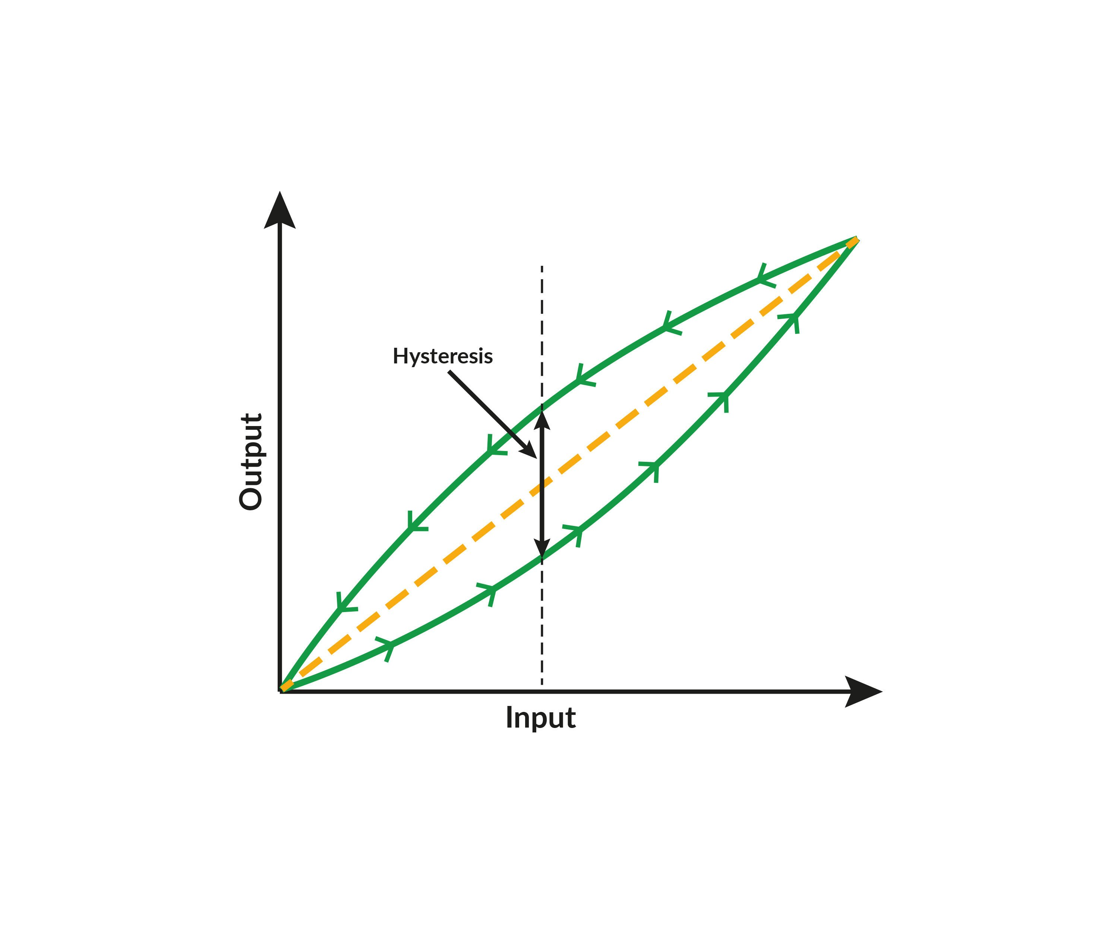
Hysteresis
Hysteresis: sensor's output depends on its input's history, causing a difference between the input value that triggers an "on" state and the value that triggers an "off" state.
Notes:
Hysteresis Example: A sensor might turn on when an object is 2 cm away but only turn off when it's 3 cm away, with the 1 cm difference being the hysteresis.

Slide 10
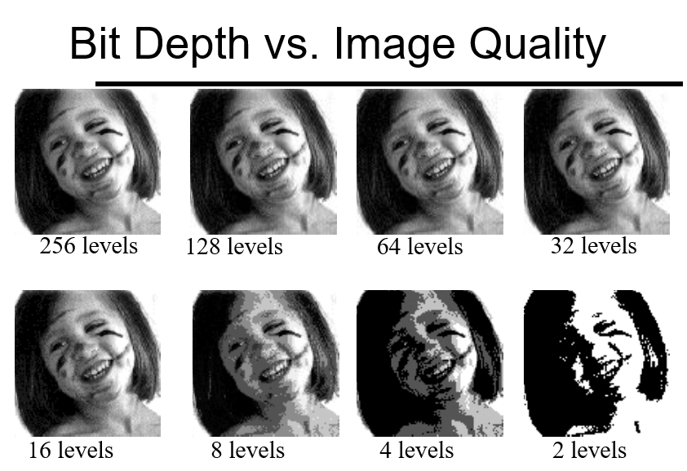
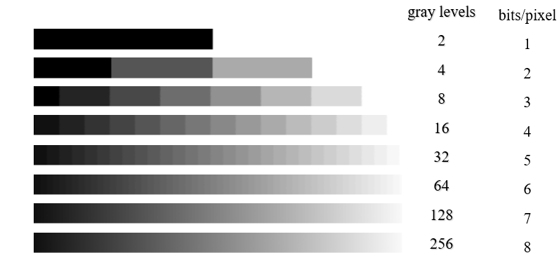
Quantization Error
Difference between the actual value of an analog signal and the nearest digital value assigned to it during analog-to-digital conversion.
→Too few quantization levels = Large quantization error, poor signal fidelity
Spaceflight examples:
Star tracker brightness: Low ADC resolution → faint stars may be lost in quantization noise.
Power system telemetry: Quantization error can hide small voltage/current variations in spacecraft batteries.
Communications: Quantization noise limits dynamic range in digital signal processing for radios and telemetry.

Slide 11
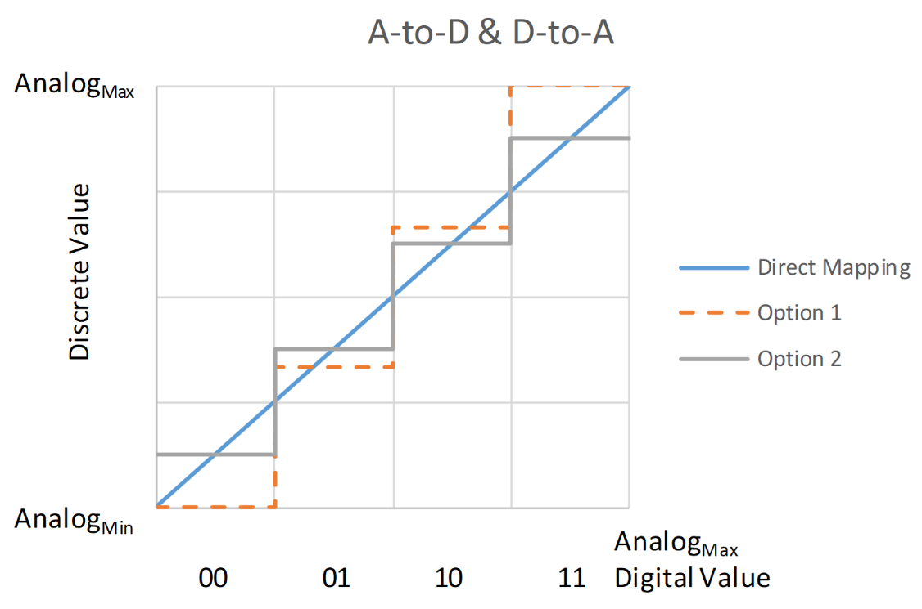
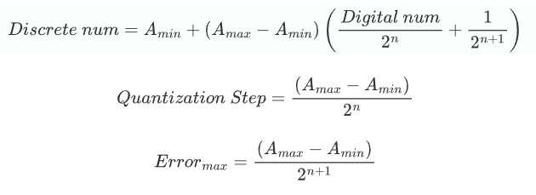
Quantization Error - Example
16 V
Option 2
Analog Range | Discrete Value | Max Error
0-4 V | 2 V | 2 V
4-8 V | 6 V | 2 V
8-12 V | 10 V | 2 V
12-16 V | 14 V | 2 V
Analog signal
0 V
How many bits is this example?
→ 2 bits/4 levels (n = 2)

Slide 12

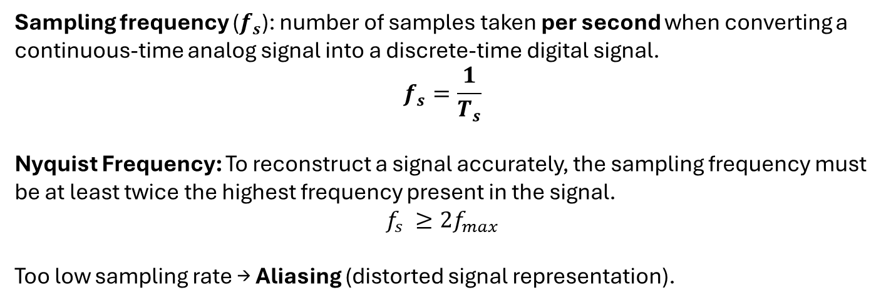
Sampling Frequency
Sampling frequency ($f_{s}$): number of samples taken per second when converting a continuous-time analog signal into a discrete-time digital signal.
$$f_{s}=\frac{1}{T_{s}}$$
Nyquist Frequency: To reconstruct a signal accurately, the sampling frequency must be at least twice the highest frequency present in the signal.
$$f_{s} ≥2f_{max}$$
Too low sampling rate → Aliasing (distorted signal representation).
$T_{s}$ - Sampling Period (sec)
$f_{max}$ - max frequency in signal
Actual signal
Dots = measurements
Reconstructed signal
Notes:
Animation showing how aliasing (frequency ambiguity) is a result of sampling a continuous waveform.
Upper left: Animation depicts a sequence of sinusoids, each with a higher frequency than the previous ones. These "true" signals are also being sampled (blue dots) at a constant frequency/rate, fs.
Upper right: The continuous Fourier transform of the sinusoid (not the samples). The single non-zero component, depicting the actual frequency, means there is no ambiguity.
Lower right: The discrete Fourier transform of just the available samples. The presence of two components means the samples can fit at least two different sinusoids, one of which is the true frequency (upper-right).
Lower left: Using the same samples (now in orange), the default reconstruction algorithm (i.e. in the absence of collateral information) produces the lower-frequency sinusoid.

Slide 13
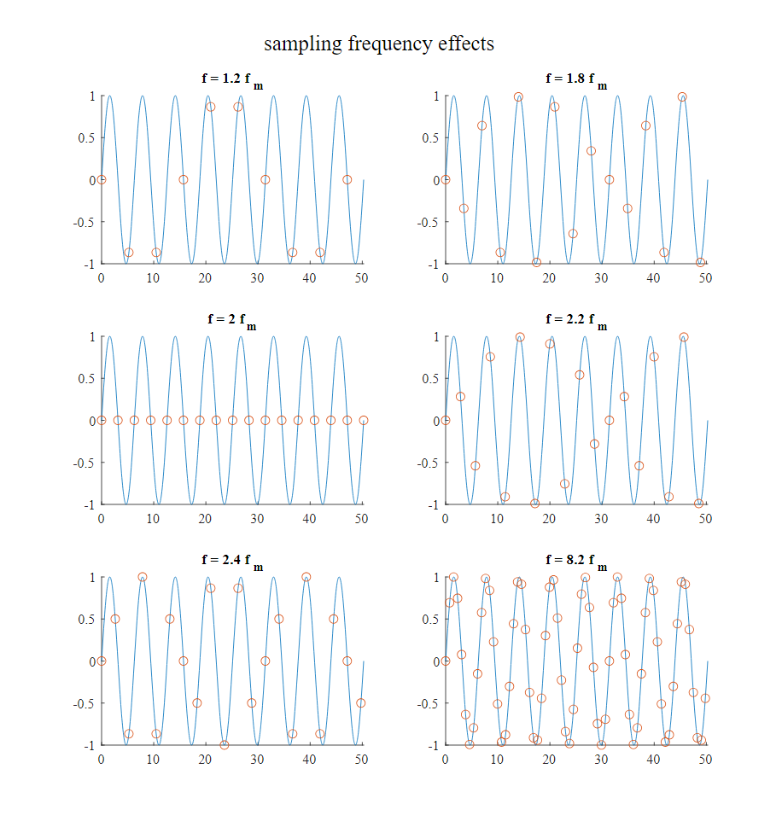
Sampling Frequency - Example
Notes:
*Draw on board

Slide 14
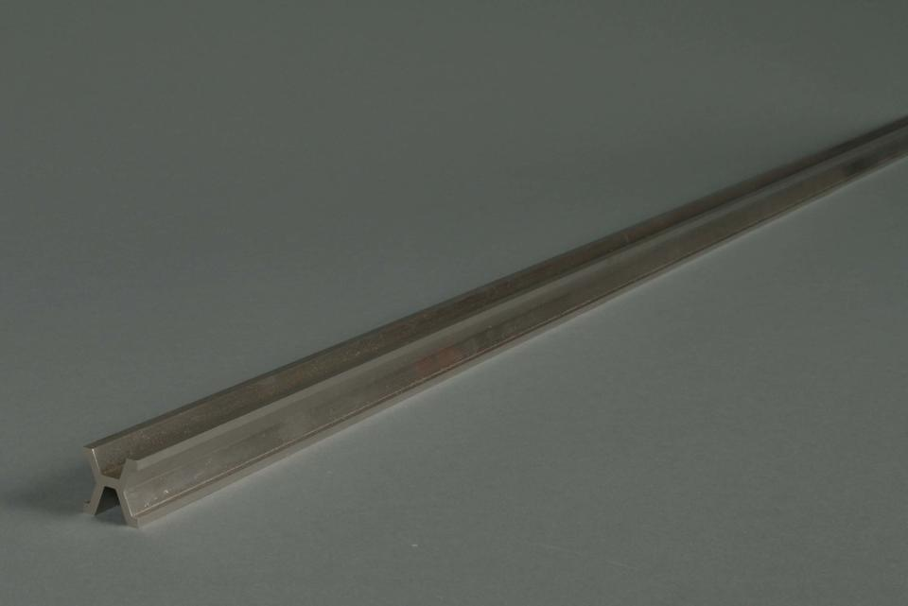
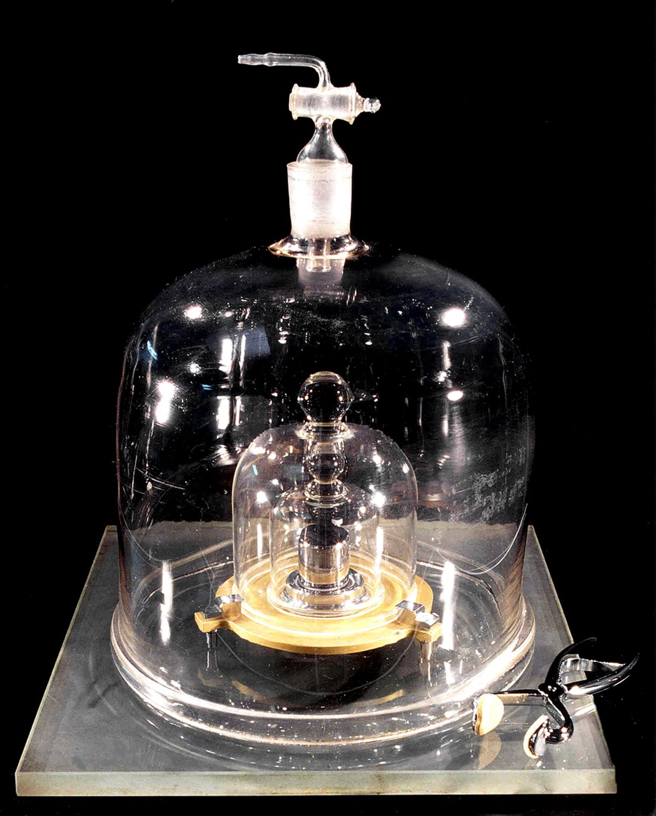
Traceability
A measurement must be able to be linked back, through a chain of calibrations, to internationally recognized standards.
Example of a Traceability Chain
Temperature measured by a spacecraft sensor
→ Sensor calibrated against a reference thermometer
→ Reference thermometer calibrated against a national standards lab (e.g. NIST)
→ National standard linked to the SI definition of the kelvin.
The International Prototype Kilogram, aka Le Grand K.
International Meter. National Prototype No. 27
→ certified to have a length of:
1 m-1.6 µm + 8.657 µm*T + 0.001 µm*T2 ± 0.2 µm
(T = temp deg C)
Notes:
National Institute of Standards and Technology (NIST)
https://www.nist.gov/si-redefinition/kilogram-introduction
https://www.nist.gov/image/meter-bar-27

Slide 15
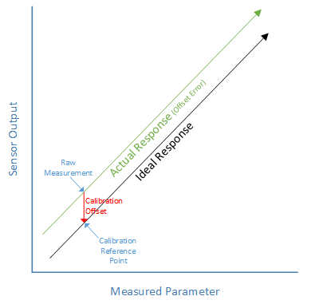
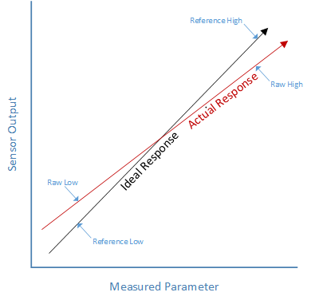
Calibration
The process of comparing output of a measurement instrument against a known standard and adjusting it to reduce errors.
Types of Calibration
Factory Calibration: Done by the manufacturer before shipping.
One-point Calibration: Sets offset at a single reference value.
Multi-point Calibration: Uses several reference points to map non-linearities.
Field Calibration: Performed in the operating environment to correct for drift or environmental effects.
General Calibration Process
Define the measurement range and accuracy requirements.
Expose the device to known reference values (e.g., temperature, pressure, voltage).
Record sensor outputs vs. reference values.
Compute calibration coefficients (offset, scale factor, non-linearity).
Apply corrections in hardware or software.
Document results for traceability.
One-point Calibration
Two-point Calibration
https://learn.adafruit.com/calibrating-sensors
Notes:
https://learn.adafruit.com/calibrating-sensors/why-calibrate

Slide 16
Software and Estimation as Metrology Tools
Sensors Alone Are Not Enough
Raw measurements are rarely usable directly
Role of Estimation
Sensor fusion
Bias estimation
Noise filtering
Example
IMU + star tracker + estimator outperform either sensor alone

Slide 17
When NASA Lost a Spacecraft Due to a Metric Math Mistake
Notes:
Mars Climate Orbiter (MCO) — one of NASA’s most famous mission failures, and a classic case study for space systems engineering and metrology:
Mission Background
Launched: December 11, 1998 on a Delta II rocket.
Mission Goal: Study Mars’ climate, atmosphere, and surface changes; act as a communications relay for the Mars Polar Lander.
Spacecraft Cost: About $327 million.
What Went Wrong
During trajectory corrections, the spacecraft entered the Martian atmosphere too low (around 57 km instead of ~140 km).
At that altitude, drag forces destroyed the spacecraft during orbital insertion.
The Root Cause: Unit Conversion Error
The spacecraft’s navigation system expected thruster data in metric units (newton-seconds).
However, the ground software team at Lockheed Martin produced the data in imperial units (pound-seconds).
This mismatch was never caught during system integration and verification.
Engineering and Systems Lessons
Metrology Failure
No consistent unit system across teams → lack of traceability.
This is why space engineering insists on SI units (and explicit unit documentation).
Verification and Validation Failure
The software passed internal tests but was never cross-checked against mission requirements in an end-to-end simulation.
Communication & Systems Engineering
NASA’s Jet Propulsion Laboratory (JPL) and Lockheed Martin used different assumptions.
Weak interface control documentation (ICD) let the error slip through.
Impact
The spacecraft burned up in Mars’ atmosphere on September 23, 1999.
Loss of $327M and critical science objectives.
Tarnished NASA’s Mars exploration program and caused restructuring in how missions handled systems engineering, verification, and unit consistency.
Takeaway
The Mars Climate Orbiter wasn’t lost due to a hardware defect or rocket failure, but because of a simple unit conversion oversight that propagated through the system unchecked.
It remains one of the best real-world examples to teach:
Importance of calibration and metrology (units matter!).
Rigorous systems engineering with interface control.
Value of verification and validation in mission assurance.

Slide 18
World's Heaviest Weight

